Slide 1
Apache Camel – Training - Day-7
Documented By
Manikanta Jakkampudi

Slide 2
Agenda
Fuse and OSGi
Deploy Camel applications to Apache-Karaf
Monitoring Camel application in Production
Miscellaneous features

Slide 3
Fuse and OSGi
What is OSGi [Open Source Gateway initiative]:
OSGi is a layered module system for the Java platform that offers a complete dynamic component model.
It’s a truly dynamic environment where components can come and go without requiring a reboot (hot deployment).
Apache Camel is OSGi-ready, in the sense that all the Camel JAR files are OSGi-compliant and are deployable in OSGi containers.
OSGi provides a vendor-independent, standards-based approach to modularizing Java software applications and infrastructure.
What is Fuse:
Red Hat JBoss Fuse is an open source Enterprise Service Bus (ESB) that focuses on mediating, transforming, and routing data across multiple applications, services, or devices for both internal systems and external services.
Apache Camel: Red Hat JBoss Fuse utilizes Apache Camel for building integration and routing solutions using Enterprise Integration Patterns (EIPs).

Slide 4
Apache karaf
Apache CXF: Red Hat JBoss Fuse's embedded Web and RESTful services framework is based on Apache CXF.
Apache ActiveMQ: Red Hat JBoss Fuse's embedded messaging service is based on Apache ActiveMQ.
Fabric8: Fuse Fabric is a technology layer that allows a group of containers to form a cluster that shares a common set of configuration information and a common set of repositories from which to access runtime artifacts.
Apache Karaf:
Karaf Runtime is a modulith runtime.
It's a lightweight, powerful, and enterprise ready.
Karaf supports several frameworks and programming model: REST/API, web, Spring Boot, ...
Karaf can be use as a standalone immuatable runtime, or in a mutable runtime that you can manage remotely.

Slide 5
Apache karaf …Continued
Hot deployment
Dynamic configuration
Logging system
Provisioning
Shell console
Remote management
WebConsole
Security
Instances management
Docker and cloud ready

Slide 6
Deploying Camel application to Apache-karaf
Setting up Maven to generate an OSGi bundle:
In the pom.xml file, set the packaging element to bundle, which means the JAR file will be packaged as an OSGi bundle:
<packaging>bundle</packaging>
To generate the MANIFEST.MF entry in the JAR file, you can use the Apache Felix Maven Bundle plugin, which is added to the pom.xml file under the <build> section…
The interesting part of this maven-bundle-plugin is its ability to set the packages to be imported and exported.
The plugin is set to export required packages from application.
In terms of imports, the preceding code defines it as dynamic by using an asterisk, which means the OSGi container will figure it out. When needed, you can specify the imports by package name.

Slide 7
Deploying Camel application to Apache-karaf
Maven Felix Plugin config in pom.xml:
<build>
<plugin>
<groupId>org.apache.felix</groupId>
<artifactId>maven-bundle-plugin</artifactId>
<version>2.1.0</version>
<extensions>true</extensions>
<configuration>
<instructions>
<Bundle-Name>${project.artifactId}</Bundle-Name>
<Bundle-SymbolicName>riderautoparts-osgi</Bundle-SymbolicName>
<Export-Package>APPLICATION PACKAGES TO BE EXPORTED TO JAR</Export-Package>
<Import-Package>*</Import-Package><!– DEPENDENCIES TO BE IMPORTED FROM OSGi -->
<DynamicImport-Package>*</DynamicImport-Package>
<Implementation-Title>Rider Auto Parts OSGi</Implementation-Title>
<Implementation-Version>${project.version}</Implementation-Version>
</instructions>
</configuration>
</plugin>
</build>

Slide 8
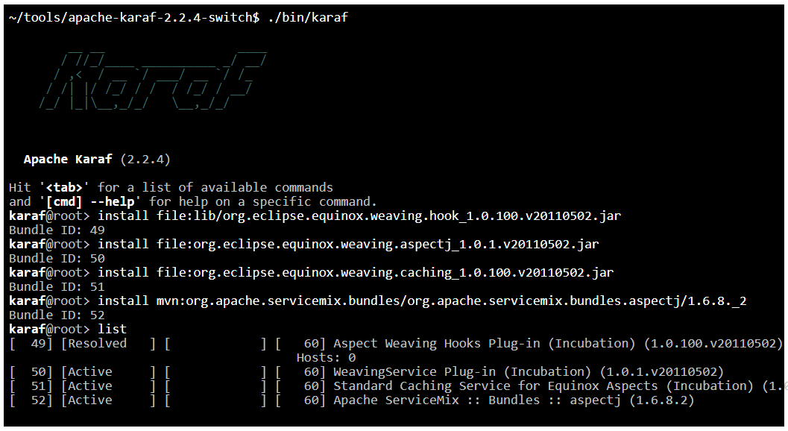
Deploying Camel application to Apache-karaf
Karaf can install OSGi bundles from various sources, such as the filesystem or the local Maven repository.
To install using Maven, first need to install the application in the local Maven repository, which can easily be done by running mvn install.
After the JAR file has been copied to the local Maven repository, now can deploy it to Apache Karaf using the following command from the shell:
osgi:install mvn:org.apache.servicemix.bundles/org.apache.servicemix.bundles.aspectj/1.6.8._2
osgi:install file:org.eclipse.equinox.weaving.caching_1.0.100.v20110502.jar
Upon installing any JAR to Karaf (a JAR file is known as a bundle in OSGi terms), Karaf will output on the console the bundle ID it has assigned to the installed bundle.

Slide 9
Monitoring Camel application in Production
Camel applications health check can occur at three levels:
■ Network level - This is the most basic level, where it need to check that the network connectivity is working.
■ JVM level - At this level, it need to check the JVM that hosts the Camel application. The JVM exposes a standard set of data using the JMX technology.
■ Application level - Here we need to check the Camel application using JMX or other
techniques.
Using JMX with Camel
To use JMX with Camel, you need the following four Spring JAR files on the classpath:
■ spring-core.jar
■ spring-beans.jar
■ spring-context.jar
■ spring-aop.jar
These JARs are needed because Camel uses Spring JMX to expose its managed beans to the JMX server.

Slide 10
Monitoring Camel application in Production…Continued
Using Spring JMX is much easier than using the low-level clumsy JMX API. With Spring JMX, you can add a few JMX annotations in the Camel codebase to expose the information you want to manage from JMX.
With Maven, it’s easy to ensure that the JARs are included in the classpath – just add a dependency for the camel-spring component:
<dependency>
<groupId>org.apache.camel</groupId>
<artifactId>camel-spring</artifactId>
<version>x.x.x</version>
</dependency>
Using JConsole to manage Camel
Java provides a JMX tool named JConsole. You’ll use it to connect to a Camel instance and see what information is available.

Slide 11
Monitoring Camel application in Production…Continued

Slide 12
Monitoring Camel application in Production…Continued
Categories of exposed Camel Mbeans
Category | Description
Components | Lists the components in use.
Consumers | Lists all the input consumers for the Camel routes. Some consumers have additional information and operations, such as the JMS, Timer, and File/FTP consumers.
Context | Identifies the CamelContext itself. This is the MBean you need if you want to shutdown Camel.
Endpoints | Lists the endpoints in use.
Errorhandlers | Lists the error handlers in use. You can manage error handling at runtime, such as by changing the number of redelivery attempts or the delay between redeliveries.
Routes | Lists all the routes in use. Here you can obtain route statistics, such as the number of messages completed, failed, and so on.
Services | Lists miscellaneous services in use.
Threadpools | Lists all the thread pools in use. Here you can obtain statistics about the number of threads currently active and the maximum number of threads that have been active. You can also adjust the core and maximum pool size of the thread pool.
Tracers | Allows you to manage the Tracer service. The Tracer is a Camel-specific service that’s used for tracing how messages are routed at runtime.

Slide 13
Monitoring Camel application in Production…Continued
Using JConsole to remotely manage Camel
To be able to remotely manage Camel, you need to instruct Camel to register a JMX connector. That can be done in the following three ways:
■ Using JVM properties
■ Configuring the ManagementAgent from Java
■ Configuring the JMX agent from Spring XML
We’ll go over each of these three methods in the following sections.
USING JVM PROPERTIES
By specifying the following JVM property on JVM startup, you can tell Camel to create a JMX connector for remote management:
-Dorg.apache.camel.jmx.createRmiConnector=true

Slide 14
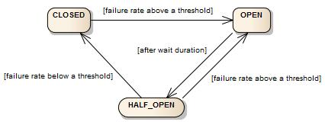
Miscellaneous – Circuit Breaker
Circuit Breaker with Resilience4j:
The circuit breaker uses a monitoring and feedback mechanism called the HALF-OPEN state to know if and when the Supplier Microservice has recovered.
It uses this mechanism to make a trial call to the upplier microservice periodically to check if it has recovered.
The CircuitBreaker is implemented via a finite state machine with three normal states: CLOSED, OPEN and HALF_OPEN and two special states DISABLED and FORCED_OPEN.
The CircuitBreaker uses a sliding window to store and aggregate the outcome of calls
Two types of mechanisms:
Count-based sliding window
Time-based sliding window
Providers of Mechanism:
Resilience4j
Hystrix

Slide 15
Miscellaneous – Circuit Breaker
from("timer:trigger?period=2000").routeId("RESILIENCE4J_ROUTE").streamCaching()
.bean("counterBean")
.log("Client request: ${body}")
.circuitBreaker().resilience4jConfiguration().
.to("http://myhost:9090/service1")
.onFallback()
.transform().constant("Fallback message")
.endCircuitBreaker()
.log("Client response: ${body}");
Maven dependency:
<dependency>
<groupId>org.apache.camel</groupId>
<artifactId>camel-resilience4j</artifactId>
<version>x.x.x</version><!-- use same version as your Camel core version --> </dependency>
<dependency>
<groupId>org.apache.camel.springboot</groupId>
<artifactId>camel-resilience4j-starter</artifactId>
<version>x.x.x</version>
</dependency>

Slide 16
Miscellaneous - A story of lost message
A story of lost message:
public void testNoConnectionToDatabase() throws Exception {
RouteBuilder replacement = new RouteBuilder() {
public void configure() throws Exception {
interceptSendToEndpoint("jdbc:*") ← Simulates no connection to database
.throwException(new ConnectException("Cannot connect"));
}
};
RouteDefinition route = context.getRouteDefinition(“ACTUAL_ROUTE_ID");
route.adviceWith(context, replacement);
String sql = "select count(*) from partner_metric";
assertEquals(0, jdbc.queryForInt(sql));
String xml = "<?xml version=\"1.0\"?>”;
template.sendBody("activemq:queue:partners", xml);
Thread.sleep(5000);
assertEquals(0, jdbc.queryForInt(sql));
}
what happened to the message sent to the JMS queue? It was not stored in the database, so where did it go?
It turns out that the message is lost because we are not using transactions. By default,
the JMS consumer uses auto-acknowledge mode, which means the client acknowledges the
message when it’s received, and the message is dequeued from the JMS broker.
What we must do instead is use transacted acknowledge mode.

Slide 17
Miscellaneous
Ordering routes:
The order in which routes are started and stopped becomes more and more important the more interdependent the routes are.
By default a route is auto started.
For example, you may have reusable routes that must be started before being leveraged by other routes.
Also, routes that immediately consume messages that are bound for other routes may have to be started later to ensure that the other routes are ready in time.
To control the startup order of routes, Camel provides two options:
AutoStartup and StartupOrder.
The routes are stopped in the reverse order in which they were started.
public class InventoryRoute extends RouteBuilder {
@Override
public void configure() throws Exception {
from("cxf:bean:inventoryEndpoint")
.routeId("webservice").startupOrder(2)
.to("direct:update")
.transform().method("inventoryService", "replyOk");
from("file://target/inventory/updates")
.routeId("file").startupOrder(1)
.split(body().tokenize("\n"))
.convertBodyTo(UpdateInventoryInput.class)
.to("direct:update")
.end();
}
}

Slide 18
Miscellaneous
Starting and stopping routes at runtime
You can start and stop routes at runtime in several ways, including these:
■ Using CamelContext - By invoking the startRoute and stopRoute methods.
■ Using RoutePolicy - By applying a policy to routes that Camel enforces automatically at runtime.
■ Using JMX - By obtaining the ManagedRoute MBean for the particular routes and invoking its start or stop methods. If you have remote management enabled, you can control the routes from another machine.
Using CamelContext to start and stop routes at runtime
from("file://target/inventory/manual?maxMessagesPerPoll=1")
.routeId("manual").noAutoStartup()
.log("Doing manual update with file ${file:name}")
.split(body().tokenize("\n"))
.convertBodyTo(UpdateInventoryInput.class)
.to("direct:update")
.end()
.process(new Processor() {
public void process(Exchange exchange) throws Exception {
exchange.getContext().getInflightRepository().remove(exchange);
exchange.getContext().stopRoute("manual");
}
});

Slide 19
Thank You

